Slide 1
Credit Risk Programme
Module 2
The Retail Product

Slide 2
Learning Objectives
At the end of this session, you will be able to:
Describe the Retail Banking (RB) product cycle from a customer’s perspective
Define the RB Credit Cycle of a facility
Understand the design elements of Retail Banking Products
Identify product design elements as they relate to risk mitigation

Slide 3
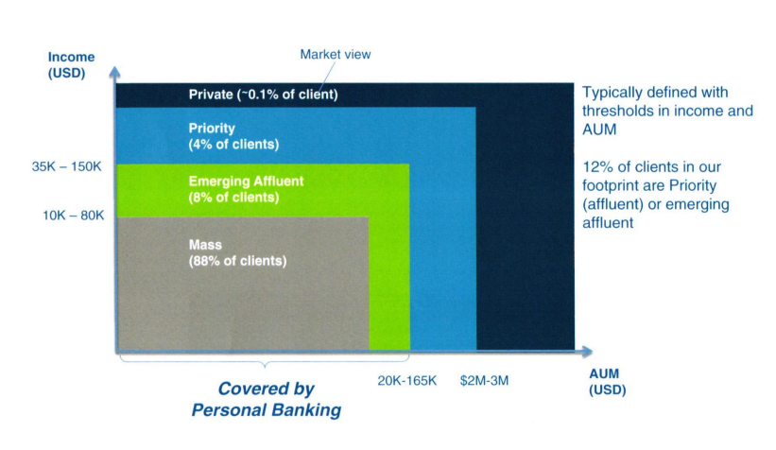
Segments in Retail banking

Slide 4
What Characteristics Describe these Target Populations?
 | Customer Life Cycle
 | Young | Middle | Mature | Retired
Age
Income
Employment
Financial Behaviour
Credit Need
What Else?

Slide 5
What Product Should be Offered to Each Group?
 | Customer Life Cycle
 | Young | Middle | Mature | Retired
Credit Card
Mortgage
Personal Loan
Overdraft
Line of Credit
Instalment
Other Innovations?

Slide 6

Common Risks for Consumer Lending Businesses
Credit/Direct lending risk
Documentation risk
Operations/Process risk
System risk
Fraud risk
Collateral risk
Interest rate risk
Price risk
Legal/Regulatory risk
Political (sovereign) risk
Disaster/Event risk

Slide 7
Credit Cycle
Product
Strategy
Underwriting
Account Management
Collections & Recovery
Customer needs
Target market
Market Consideration
Structuring a credit product
Terms & conditions
Type of risk
Identification of borrower
Identification of security
Determination of LTV
Targeting
Segmentation
Distribution sources
Tools
Risk assessment
Line management
Credit concerns
Line increase
Line decrease
Balancing act among
  Customer
  Credit expense
  LI
Tools
Strategies

Slide 8

Consumer Lending Characteristics
Large customer base
Large volume, small loans
Utilize indirect business sourcing
Products tied to consumer life cycle needs
Limited financial data on consumers which can be supplemented with credit bureau data on their borrowing history
Process dependent, volume approval process
Portfolio management by aggregate performance statistics

Slide 9
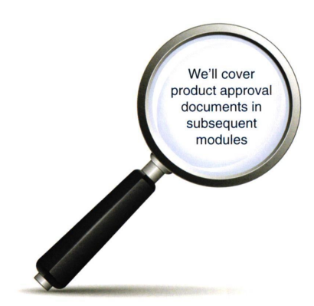
Product Planning
At the end of this session, you will be able to:
Product, target market, credit policies
Credit initiation processes
Loan impairment expectations
Level of returns – RORWA, LI%ANR, LAR%ANR
No amount of Risk Management can protect you from a poor product design

Slide 10
Retail Lending Products: Key Elements
Credit Card
Maximum Unsecured Exposure (MUE) cap at 12-24x, depending on customer segments
Debt Service Ratio (DSR) cap at 60-70%
Portfolio management actions include line increase, balance transfer, authorizations
Line increase not more 1x in the last 6 months
Payment holiday 1x in the last 12 months
Mortgage
Loan to Value (LTV) ranges from 70% - 90%
DSR cap at 65% - 70%
Amortizing loan structure (excluding “interest only” during construction up to for 3 years)
Personal Loans
MUE cap at 12x – 24x
DBR cap at 60% - 70%
Maximum tenor of typically 60 months
No negative amortization

Slide 11
Business Banking Products: Key Elements
Risk Approach
Program Lending
Standardized credit acceptance criteria for relatively homogenous target customer segments
Aim to cover 80% of risky by rules & parameters, rest by controlled used of judgements (L3)
Volume business model for standardized & simple products with smaller Limit and Net At Risk
Portfolio management for standalone term relationships (ex. BIL, GIL, Mortgage)
Rule driven client account monitoring for relationship managed customers with BWC facilities
Collections / delinquency management and rule based provisioning standard
Products
BWC
Suite of simple working capital and trade products, and FX towards for hedging
Mandate minimum credit turnover through SCB accounts
Tenor in line with purpose ( in general < 6 months, except overdraft and BG)
Requires tangible collateral: gov’t guarantees, credit insurance or product recovery as second way out
BIL / GIL
Small unsecured / partly secured term loans with maximum 3-5 years tenor for BIL, 5 years tenor for GIL
Target customer segment: SB and micro SB with annual turnover < $10M
Decisions largely based on minimum acceptance criteria, credit bureau behaviour, scorecards, proxy repayment capability calculations (DSR), supplemented by risk based credit interview and visit.
Non-Financial income proof used – i.e., bank statement official business tax statement/VAT records
Aggregate on-us and off-us unsecured exposure to mitigate over borrowing risk
Mortgage / LAP
Long tenor property secured loans
Repayment by monthly instalment
List of acceptable property types (commercial, industrial and residential) along with associated Collateral Recovery Rates (CRR) documented in Country Credit Approval Document (CAD)

Slide 12
Wealth Management Products: Key Elements
Class 1
Lending against diversified liquid collateral from investment grade issuers. LTVs determined by:
Equities - historical volatility, mkt. cap and trading volume (liquidity). 5000+ stocks with LTVS from 30-70%
Bonds - LTVS on sovereign and corporate investment grade bonds. LTVS based on tenor and issue size (minimum USD250m)
Structured products - LTVs for all 100% principal protected (PP) and select non-PP structures. List of issuers restricted to 10 global names
Mutual funds - LTVs on funds reviewed and distributed by SCB. LTVs based on volatility
Others - insurance, hedge ,funds etc. LTVs applied on individual product basis
Class 2
Lending against non-diversified, non-standard collateral which may have limited liquidity - e.g., promoter share financing. LTVS determined on bespoke basis based on review of the client, existing corporate relationship with WB etc.
Class 3
Lending against residential and commercial real estate. includes amortizing and interest-only mortgages
Class 4
Margin trading platform for sophisticated Private Bank customers offering trading across various asset classes - FX, equities, fixed income
Class 5
Provider Risk - e.g. GVEC / Maddoff
Product Risks - We have a duty of care lo ensure
Counterparty pricing is lair
Pricing clients fairly - no gouging, especially for products with a degree ol opacity
Adequate liquidity should client require early termination
Suitability & Appropriateness - risks associated with
inaccurate product risk ratings
Client investment profiling errors c) Mis-selling / vulnerable customers

Slide 13
Wealth Management Products: Key Elements
Cash
Fixed Income
Equity
Alternate
FX Deposits Loans | Bonds Perpetual | Cash Equity | Commodities e.g. Gold, Real estate
Money Market Fund | F. l. Funds | Equity Funds | Real estate Funds P.E. Fund
PCI Accumulators | CLNs Limited Liability Notes | Equity Linked Notes, DRACs | Commodity Linked Notes
Direct
Funds
Derivatives
Fiduciary & lnsurance
Credit

Slide 14
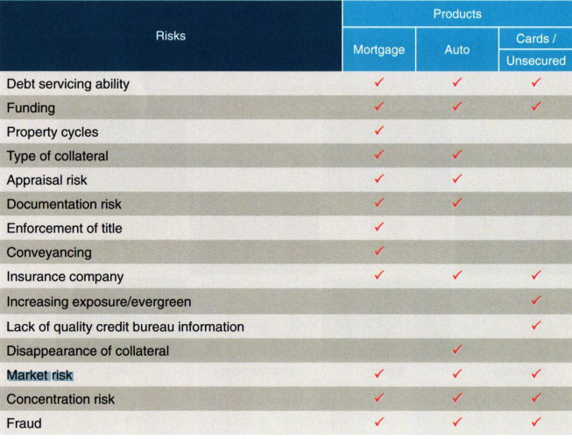
Risks by product

Slide 15
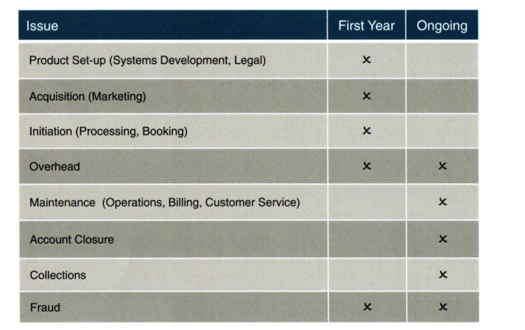
Retail Profit Model – Operating Expenses

Slide 16
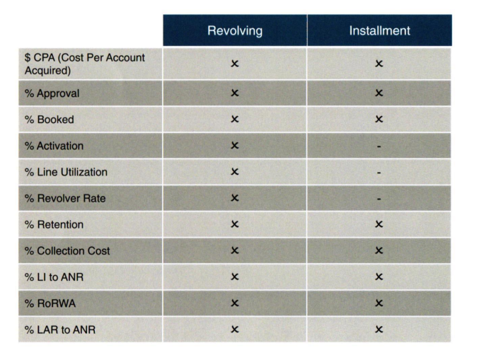
Manage Product “Drivers” to Reach Profit Objective

Slide 17
Products Summary
Each product's characteristics determine the type of risks associated with it.
These risks occur at a different stage of the product cycle.
While these risks cannot be avoided, credit policies and processes should be designed and implemented to mitigate these risks

Slide 18
Points to Remember
Let's revisit some of the most important points of this section
Good product design is a risk mitigation tool.
Product structure and features drive profitability.
Some costs are up-front, such as initiation, while others are portfolio running costs.
Some costs, such as strong underwriting systems drive long term profitability.

Slide 19

Questions

Slide 20
Notes

